Slide 1
CloudFront

Slide 2
In Reality
The client – CloudFront connection is distributed and extremely local with file and REST API caching.

Slide 3
(Some) Security Facets
Authentication: “ (…) is the act of confirming the truth of an attribute of a single piece of data claimed true by an entity. In contrast with identification, which refers to the act of stating or otherwise indicating a claim purportedly attesting to a person or thing's identity, authentication is the process of actually confirming that identity. ”
Authorization:
“The process of authorization is distinct from that of authentication. Whereas authentication is the process of verifying that ‘you are who you say you are’, authorization is the process of verifying that ‘you are permitted to do what you are trying to do’.
“Authorization is the function of specifying access rights/privileges to resources related to information security and computer security in general and to access control in particular ^{[1]}. More formally, "to authorize" is to define an access policy.”
(Communication) Security
“Transport Layer Security (TLS) and its predecessor, Secure Sockets Layer (SSL), both frequently referred to as "SSL", are cryptographic protocols that provide communications security over a computer network.”
“The connection is private (or secure) because symmetric cryptography is used to encrypt the data transmitted.”
The identity of the communicating parties can be authenticated using public-key cryptography.
The connection ensures integrity because each message transmitted includes a message integrity check using a message authentication code to prevent undetected loss or alteration of the data during transmission.
HTTPS (also called HTTP over Transport Layer Security [TLS],^{[1]} HTTP over SSL,^{[2]} and HTTP Secure^{[3][4]}) is a communications protocol for secure communication over a computer network which is widely used on the Internet. HTTPS consists of communication over Hypertext Transfer Protocol (HTTP) within a connection encrypted by Transport Layer Security, or its predecessor, Secure Sockets Layer. The main motivation for HTTPS is authentication of the visited website and protection of the privacy and integrity of the exchanged data.

Slide 4
Alice – Bob – Eve
Eve observes the unencrypted communication.
Probably to do something malicious with the observed information, e.g.
Steal credit card numbers.
Steal login IDs and passwords.

Slide 5
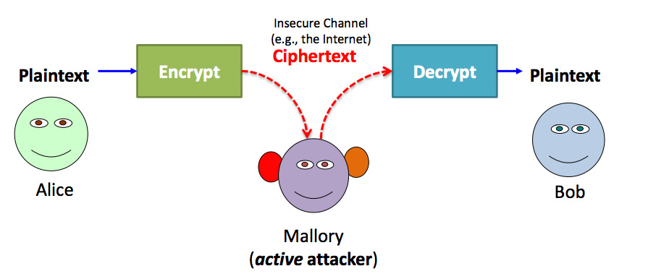
Alice – Bob – Mallory
Mallory intercepts the communication, including any security set up, e.g.
Keys
BASIC-AUTH
Makes Bob think she is Alice and Alice think she is Bob to steal information or send evil messages (e.g. transfer money).

Slide 6
HTTPS
Using
The SSL Certificate
PKI cryptography
Bob can prove identity to Alice.
Alice can send messages to Bob that only Bob can decrypt.
This allows a
Key exchange
To set up a secure channel
But, Alice has not proven identity to Bob.

Slide 7
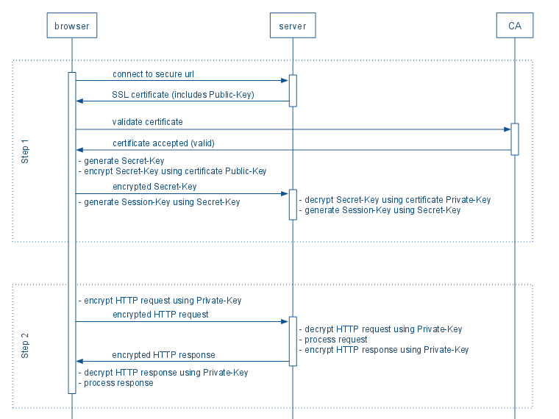
Two Diagrams Explaining HTTPS/TLS

Slide 8
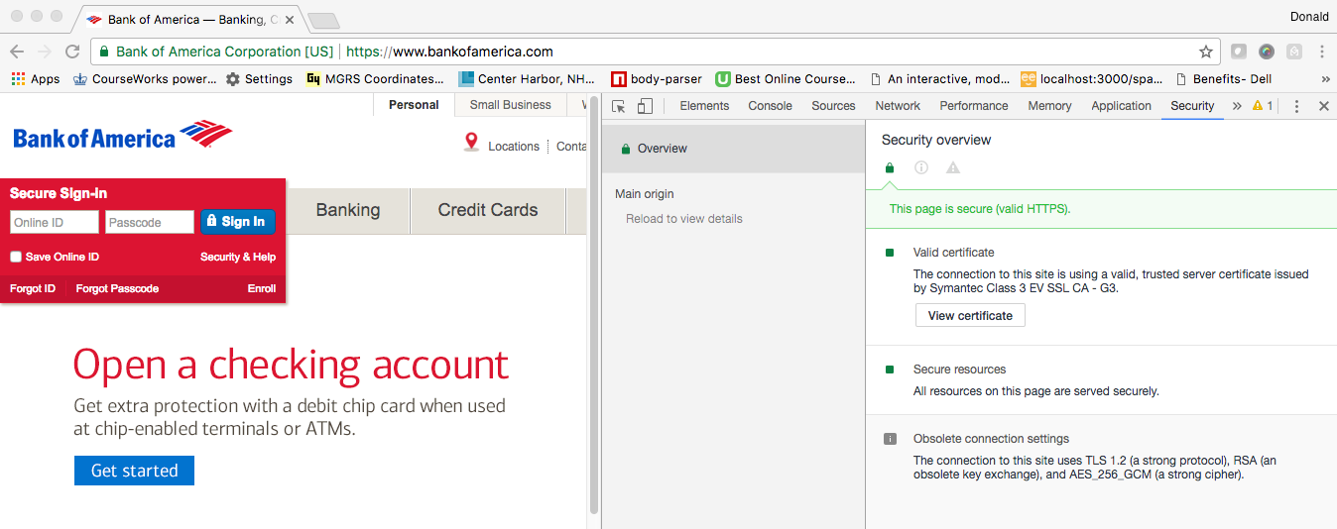
HTTPS Example
I am connected to the owner of bankofamerica.com ➔
I can send the site a shared secret, and be sure no one else can see it.
This works for REST because REST is still HTTP(S).

Slide 9
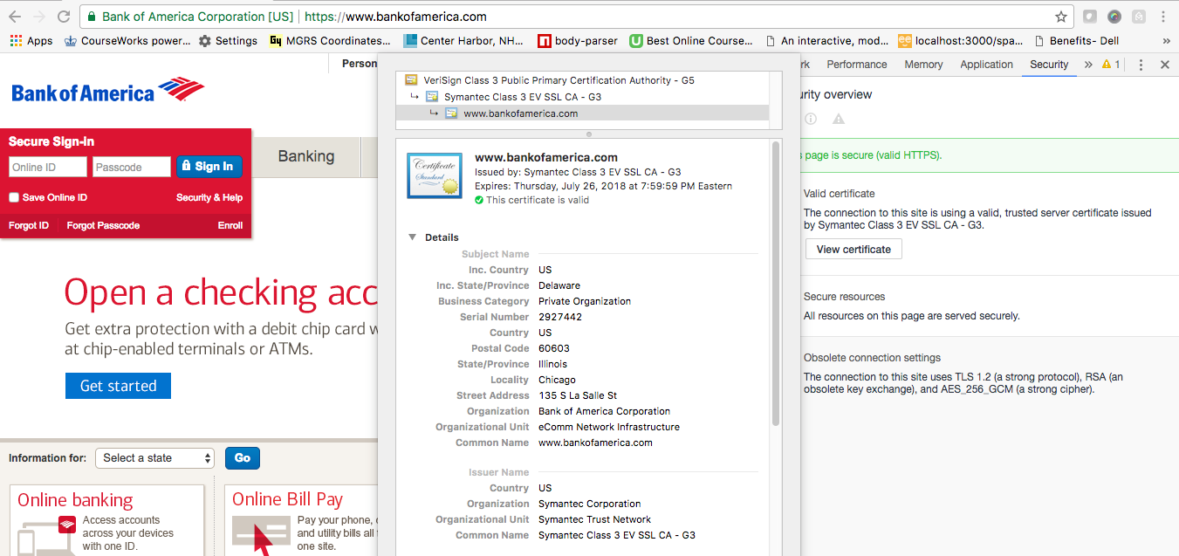
Certificate

Slide 10
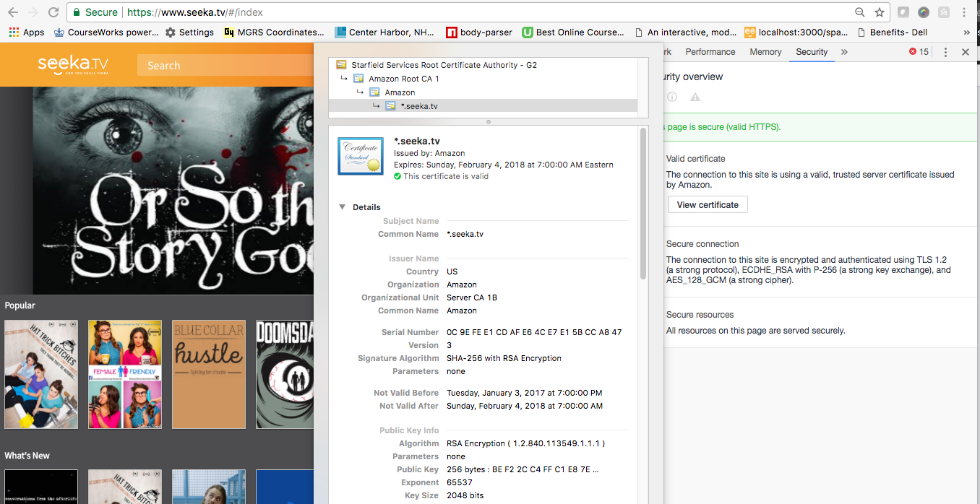
Using Your Certificate

Slide 11
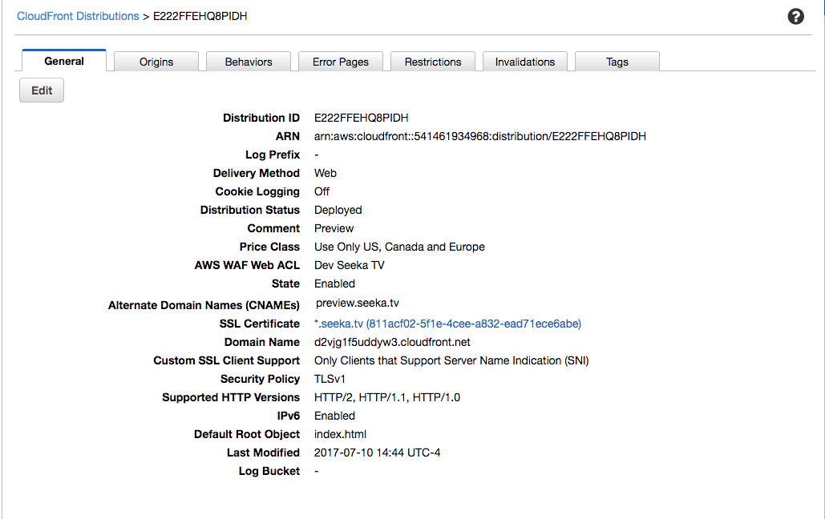
Using Your Certificate

Slide 12
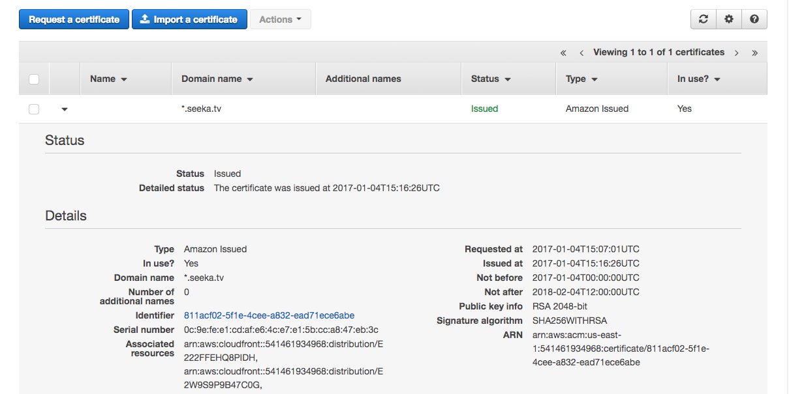
Using Your Certificate

Slide 13
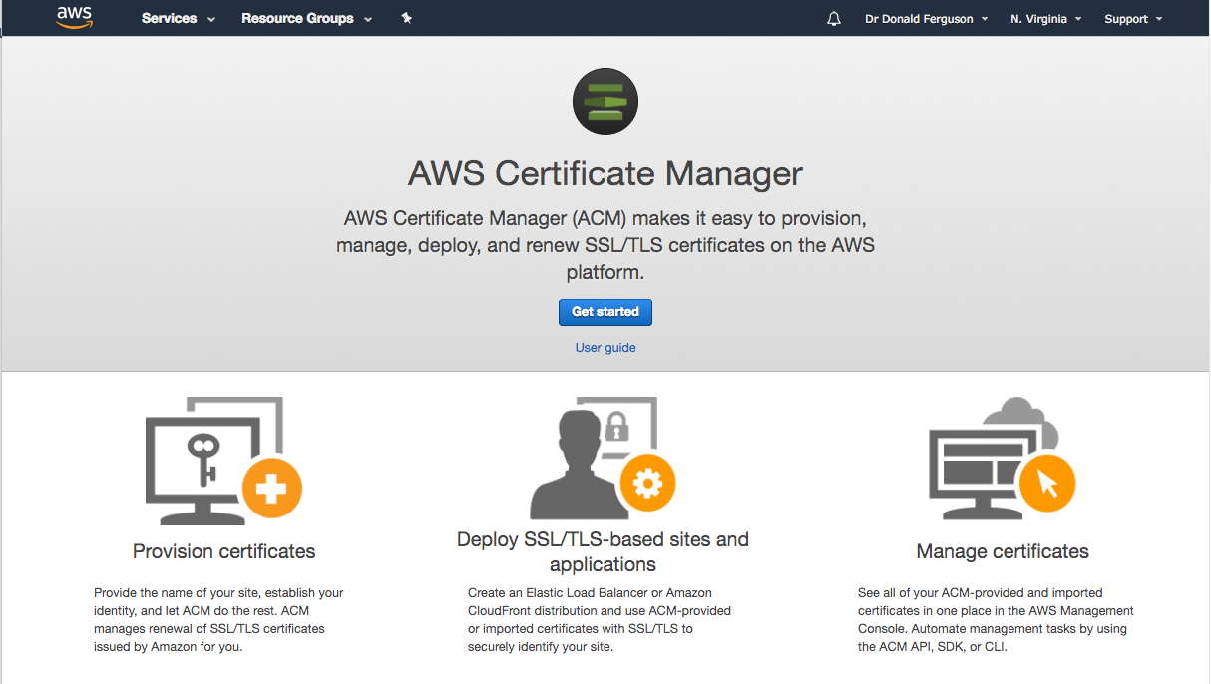
Obtaining a Certificate

Slide 14
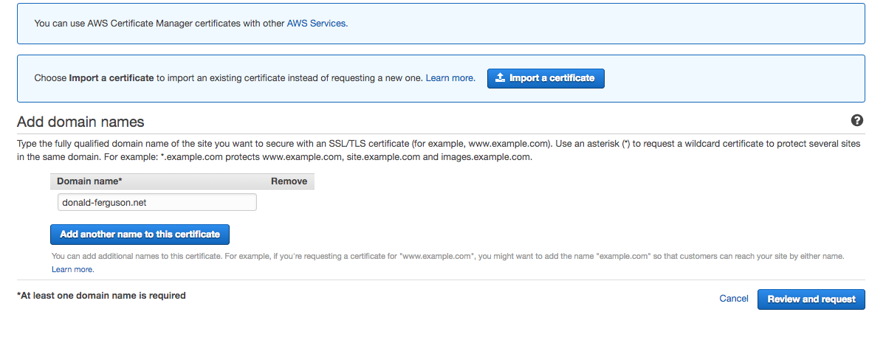
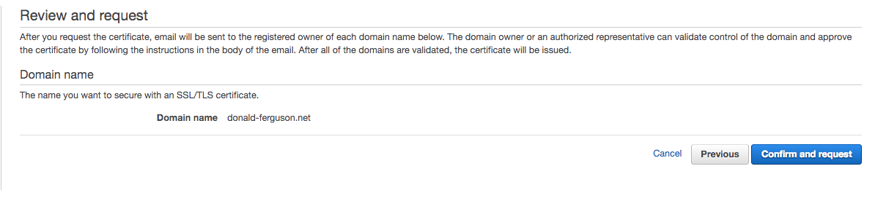

Slide 15
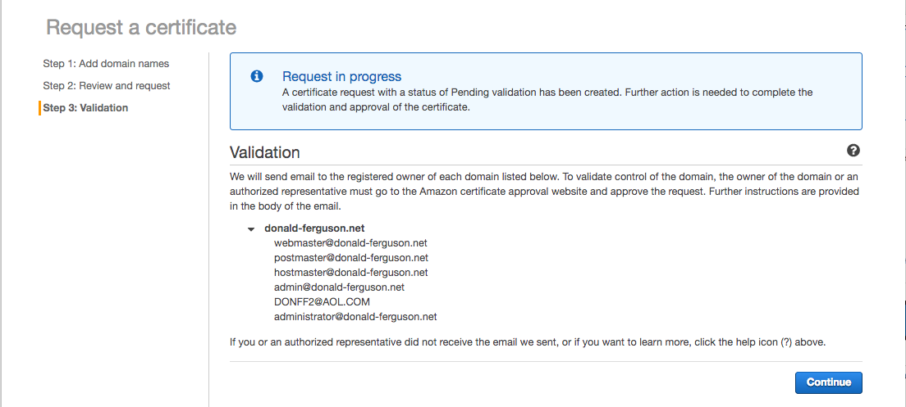

Slide 16
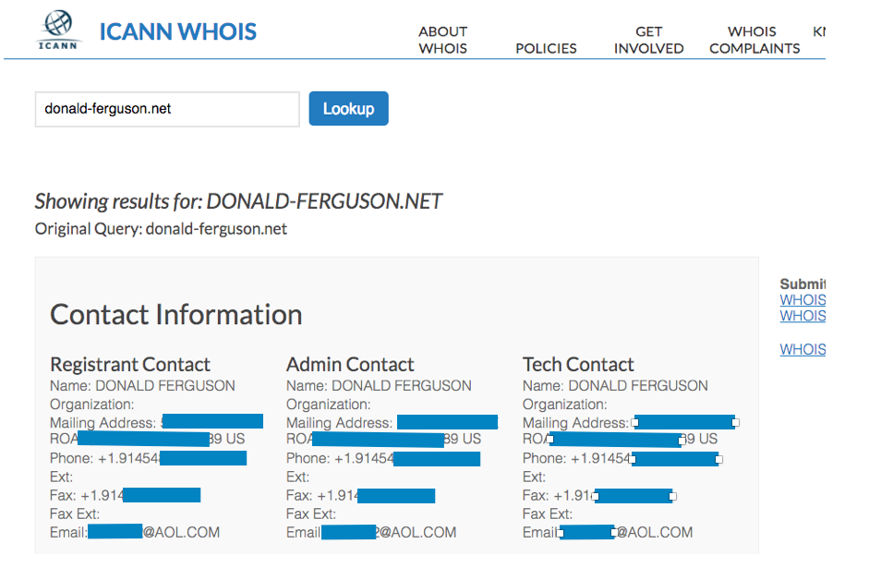
DNS Info

Slide 17
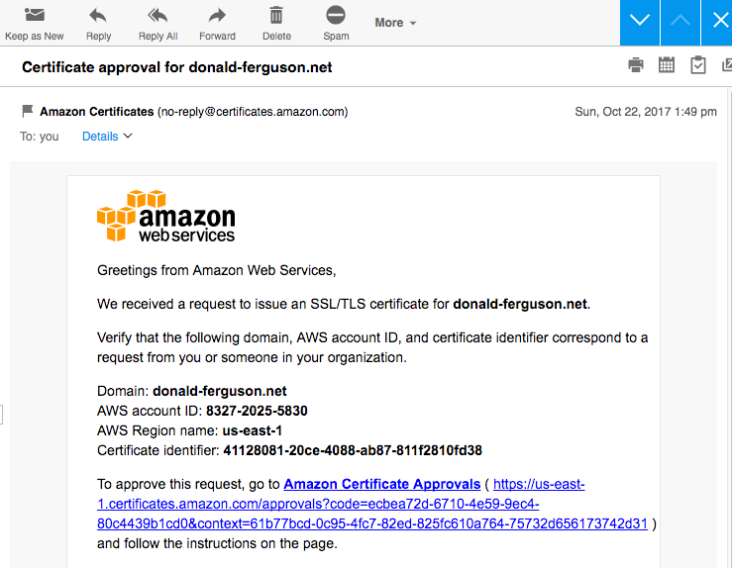

Slide 18
